Slide 1


Slide 2
Programming Fundamentals
Khurram Iqbal.
Lecturer,
Dept of Computer Science.
Academic Block-II (AB-II), First Floor,
Email: Khurram.iqbal@comsats.edu.pk

Slide 3
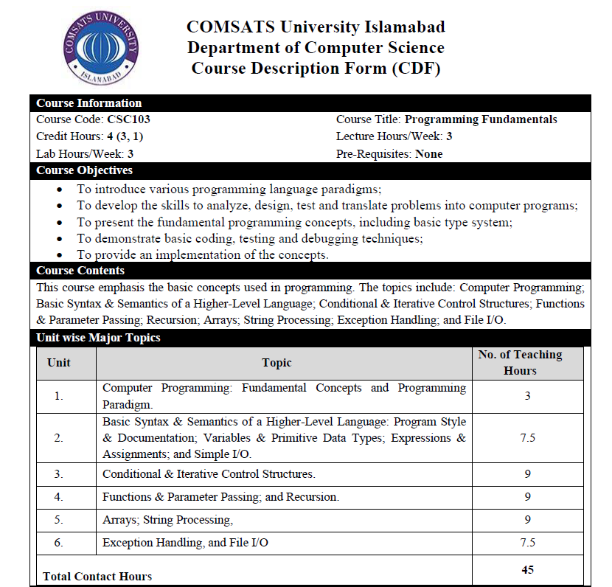

Slide 4
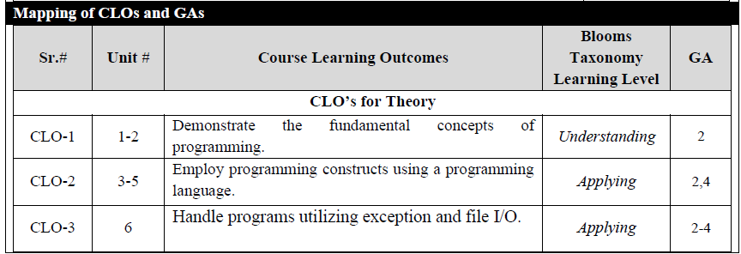
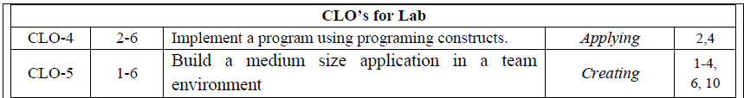

Slide 5
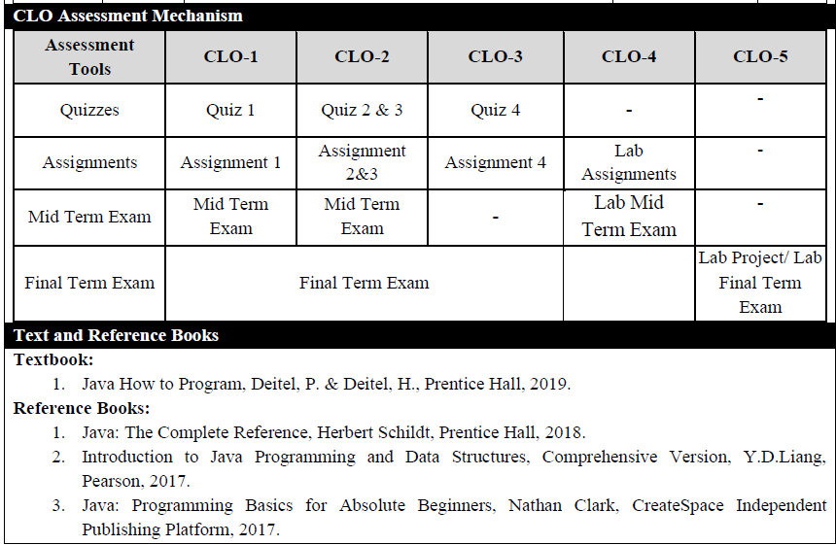

Slide 6
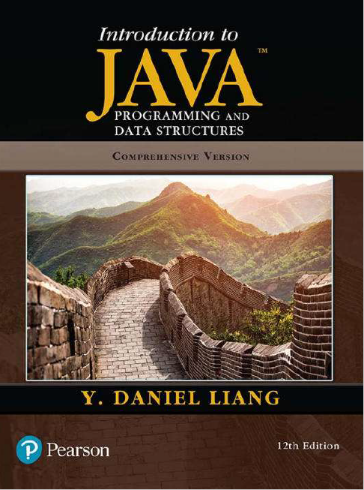

Slide 7
Course Evaluation Break Down
Evaluation methods | Theory Weight (%)[T] | Lab Weight (%)
Quizzes (4 minimum) | 15 | -
Assignments / Practical Assignments (4 minimum) | 10 | 25
Mid-Term | 25 | 25
Terminal Exam | 50 | 50
Sub Total | 100 | 100
Total | 75% | 25%

Slide 8
Course Requirements
Assignments/Quizzes/Presentation
Written assignments (Small Tasks) (details in coming lectures)
Idea is to initiate research-oriented writing not “copy-paste”
Attendance, Presentations, Quiz & Class Discussion & Participation (as a regular activity)
Volunteer presentations (you must not be that familiar with this kind of stuff, but you need to respond to it quickly!)
Formal Presentations in groups:
Mid Term: First 18 Lectures Course Contents
Terminal: Complete Course Contents

Slide 9
Rules!!!
Student coming in the class/Labs after 5 minutes will be marked as absent.
Assignments will be floated and submitted on MS Teams.
Late submission of assignment is strictly discouraged. Late assignment will not be accepted.
Turn off Cell Phones in the Class.
You are encouraged to help each other with your homework assignments – but you must turn in your own work. Total= x4
Quizzes are announced. Total= x4
If you are found to be cheating, you will fail at least the Quiz/ test and perhaps the entire class.

Slide 10


Slide 11








Our Language Choice in PF Course: Java
Java features
•Widely used. •Widely available. •Continuously under development since early 1990s. •Embraces full set of modern abstractions. •Variety of automatic checks for mistakes in programs.
James Gosling
Java economy
millions of developers
billions of devices
•Mars rover.
•Cell phones.
•Blu-ray Disc.
•Web servers.
•Medical devices.
•Supercomputing. •…
7

Slide 12
Types of Java Applications
Four types of applications that can be created using Java programming
Standalone Application
Web Application
Enterprise Application
Mobile Application

Slide 13
JDK Editions
Java Standard Edition (Java SE)
Java Enterprise Edition (Java EE)
Java Micro Edition (Java ME)

Slide 14
JDK Versions
History of JDK version
https://en.wikipedia.org/wiki/Java_version_history
Latest is Java SE 25[Java SE 25]
Download from:
https://www.oracle.com/java/technologies/downloads/#jdk23-windows

Slide 15
Installing Java
To check if Java is installed (open command prompt and type following command)
java –version
Setting Java Path
Temporary Path
Open the command prompt
Copy the path of the JDK/bin directory
Write in command prompt: set path=copied_path
Permanent Path using Environment Variables Settings

Slide 16
Environment Variable
Go to "System Properties" (Can be found on Control Panel
> System and Security > System > Advanced System Settings)
Click on the "Environment variables" button under the "Advanced" tab
Then, select the "Path" variable in System variables and click on the "Edit" button
Click on the "New" button and add the path where Java is installed, followed by \bin. By default, Java is installed in C:\Program Files\Java\jdk-15\bin
Then, click "OK", and save the settings
At last, open Command Prompt (cmd.exe) and type java - version to see if Java is running on your machine

Slide 17

Popular Java IDEs
NetBeans
Eclipse
IntelliJ

Slide 18
JDK, JRE, and JVM
Java Development Tool kit (JDK)
Software development environment which is used to develop Java applications
Physically exists
Java Runtime Environment
Set of software tools which are used for developing Java
applications
Contains JVM
JRE = JVM + rt.jar (lang, util, awt, swing, math packages)
Java Virtual Machine (JVM)
Provides a platform-independent way of executing Java source
code
JVM comes with JIT(Just-in-Time) compiler that converts Java source code into low-level machine language

Slide 19
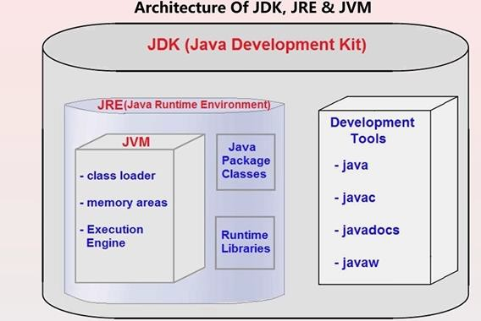
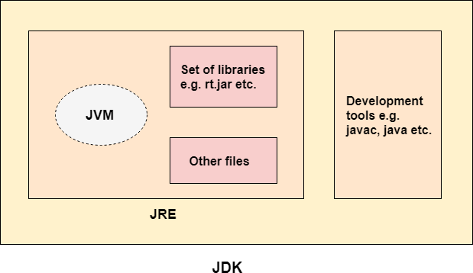
JDK, JRE, and JVM

Slide 20
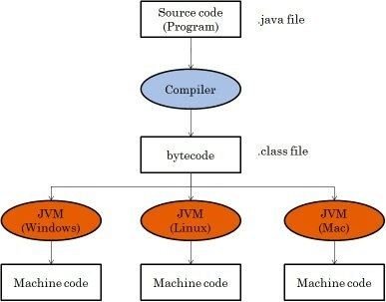

Slide 21
Interpreting/Compiling Source Code
A program written in a high-level language is called a source program or source code
A source program must be translated into machine code for execution

Slide 22
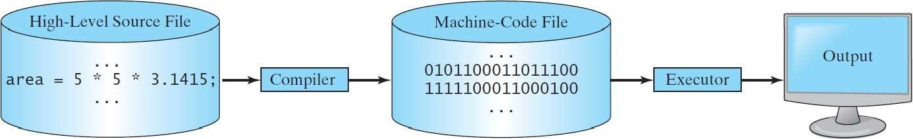
Compiling Source Code
A compiler translates the entire source code into a machine-code file, and the machine-code file is then executed

Slide 23
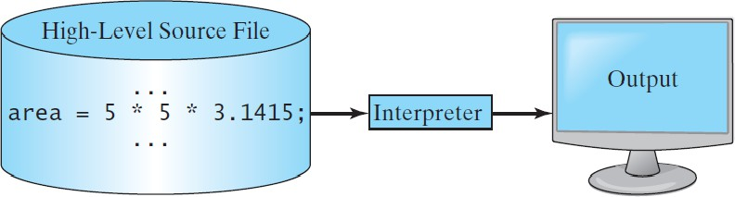
Interpreting Source Code
An interpreter reads one statement from the source code, translates it to the machine code or virtual machine code, and then executes it right away

Slide 24
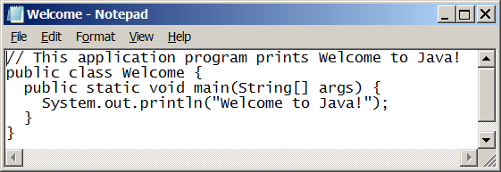
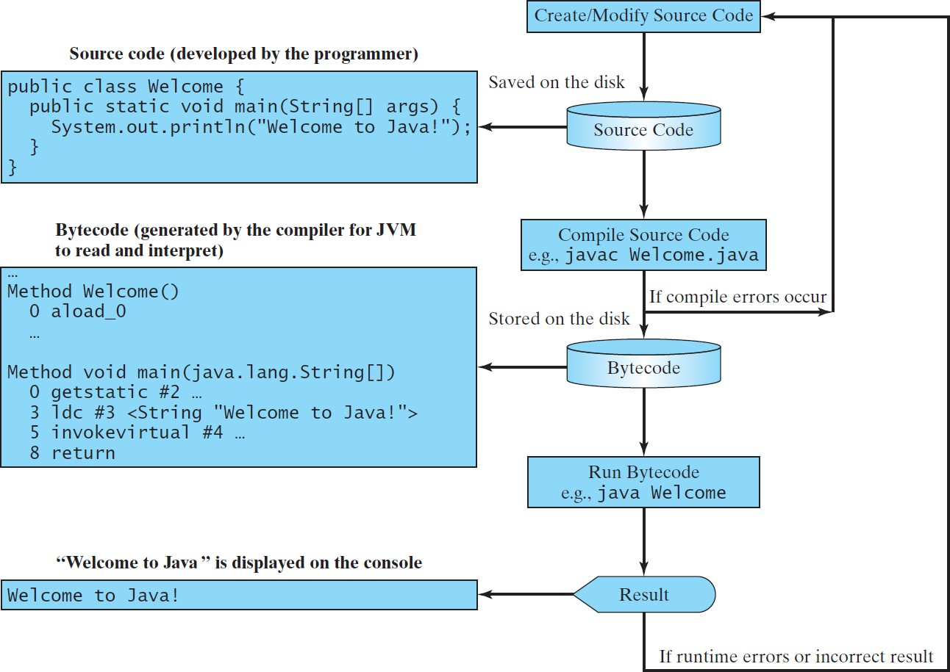
Creating, Compiling, and Running Programs

Slide 25


Java Program Phases
Phase 1: Creating a Program
Phase 2: Compiling a Java Program into Bytecodes
– Bytecodes are executed by the JVM

Slide 26
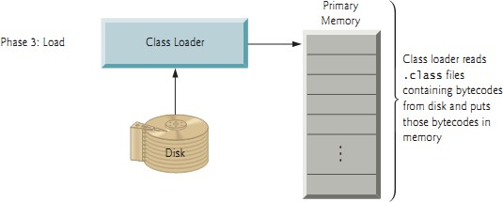
Java Program Phases
Phase 3: Loading a Program into Memory
– JVM class loader takes the .class file (along with associated class files provided by Java) and loads in memory

Slide 27
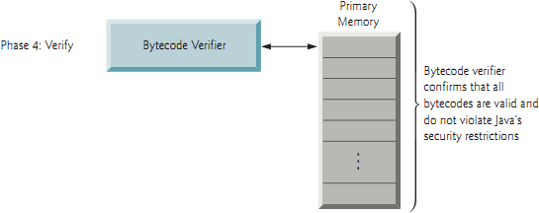
Java Program Phases
Phase 4: Bytecode Verification
– Java enforces strong security to make sure that Java programs arriving over the network do not damage your files or your system (as computer viruses and worms might).

Slide 28
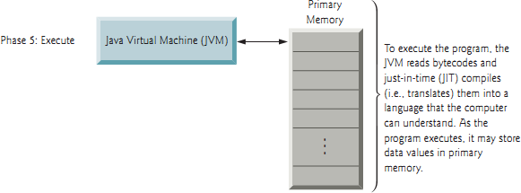
Java Program Phases
Phase 5: Execution
Interpreter
JVM execute bytecode using interpreter (one bytecode at a time) which slows execution
Just In Time(JIT) Compiler
JVM analyzes the bytecodes as they’re interpreted searching for hot
spots — parts of the bytecodes that execute frequently
For these part JIT also known as Java HotSpot compiler
– Translates the bytecodes into the underlying computer’s machine language

Slide 29
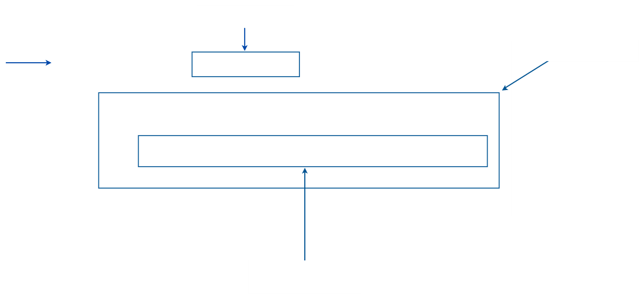

Anatomy of your ﬁrst program
program name
text file named
public class HelloWorld {
main()
method
HelloWorld.java
public static void main(String[] args) {
System.out.println("Hello, World");
}
}
body of main()
(a single statement)
10

Slide 30
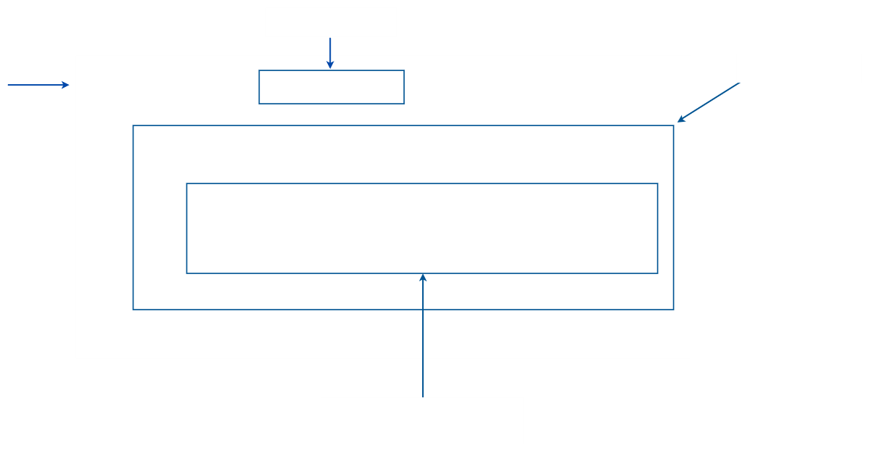

Anatomy of your next several programs
program name
text file named
public class MyProgram {
main()
method
MyProgram.java
public static void main(String[] args) {
...
}
}
body of main()
(a sequence of statements)
11

Slide 31


Pop quiz on "your ﬁrst program"
Q. Use common sense to cope with the following error messages.
% javac MyProgram.java % java MyProgram Main method not public.
% javac MyProgram.java MyProgram.java:3: invalid method declaration; return type required
public static main(String[] args)
^
12

Slide 32
Pop quiz on "your ﬁrst program"
Q. Use common sense to cope with the following error messages.
% javac MyProgram.java % java MyProgram Main method not public.
A. Must have forgotten “
public
”.
public static void main(String[] args)
% javac MyProgram.java MyProgram.java:3: invalid method declaration; return type required
public static main(String[] args)
^
A. Check
HelloWorld
. Aha! Forgot “
void
”.
public static void main(String[] args)
13

Slide 33


Three versions of the same program.
public class HelloWorld {
public static void main(String[] args) {
}
System.out.println("Hello, World");
}
/*************************************************************************
* * * * * * * * *************************************************************************/
Compilation: Execution:
javac HelloWorld.java java HelloWorld
Prints "Hello, World". By tradition, this is everyone's first program. % java HelloWorld Hello, World
public class HelloWorld {
public static void main(String[] args) {
}
System.out.println("Hello, World");
}
public class HelloWorld { public static void main(String[] args) { System.out.println("Hello, World"); } }
Lesson: Fonts, color, comments, and extra space are not relevant in Java language.
14

Slide 34
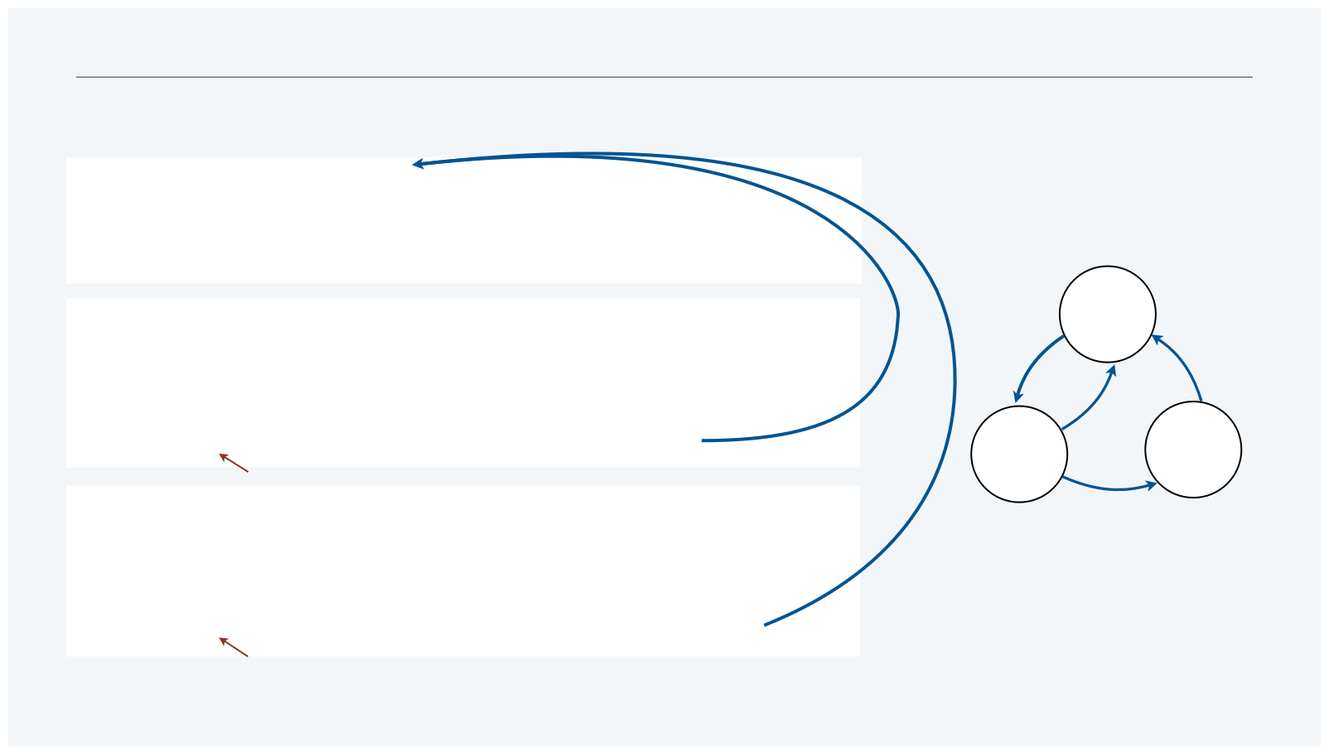
Program development in Java
is a three-step process, with feedback
1. EDIT your program
•Create it by typing on your computer's keyboard.
•Result: a text file such as HelloWorld.java.
2. COMPILE it to create an executable file
EDIT
•Use the Java compiler
•Result: a Java bytecode file such as
HelloWorld.class
•Mistake? Go back to 1. to fix and recompile.
COMPILE
RUN
not a legal Java program
3. RUN your program
•Use the Java runtime.
•Result: your program’s output.
•Mistake? Go back to 1. to fix, recompile, and run.
a legal Java program that does the wrong thing
18

Slide 35


A rich subset of the Java language vocabulary
built-in types
int long double char String boolean
operations on numeric types
+ - * / % ++ --
String
assignment
=
object oriented
static class public private new final toString() main()
Math
operations
+ "" length() charAt() compareTo() matches()
methods
Math.sin() Math.cos() Math.log() Math.exp() Math.pow() Math.sqrt() Math.min() Math.max() Math.abs() Math.PI
p
flow control
if else for while
System methods
System.print() System.println() System.printf()
punctuation
{ } ( ) , ;
comparisons
< <= > >= == !=
boolean
operations
true false ! && ||
our Std methods
StdIn.read*() StdOut.print*() StdDraw.*() StdAudio.*() StdRandom.*()
arrays
a[] length new
type conversion methods
Integer.parseInt() Double.parseDouble()
Your programs will primarily consist of these plus identifiers (names) that you make up.
9

